Slide 1
Functional Programming Methods for Analytics

Slide 2
What is a statistical package?
Statistical software are programs which are used for the statistical analysis of the collection, organization, analysis, interpretation and presentation of data.
https://www.predictiveanalyticstoday.com/top-free-statistical-software/

Slide 3
What is an analytical method?
The Analytical Method is a generic process combining the power of the Scientific Method with the use of formal process to solve any type of problem
https://www.predictiveanalyticstoday.com/top-free-statistical-software/

Slide 4
1. Identify the problem to solve.
2. Choose an appropriate process. (THE KEY STEP)
3. Use the process to hypothesize analysis or solution elements.
4. Design an experiment(s) to test the hypothesis.
5. Perform the experiment(s).
6. Accept, reject, or modify the hypothesis.
7. Repeat steps 3, 4, 5, and 6 until the hypothesis is accepted.
8. Implement the solution.
9. Continuously improve the process as opportunities arise.
http://www.thwink.org/sustain/glossary/AnalyticalMethod.htm

Slide 5
Top 10 free statistical packages
Google Analytics
Clicky
Mint
Church Analytics
KISSmetrics
Open Web Analytics
Clicktale
CrazyEgg
Piwik
CloudFlare

Slide 6

What statistical packages should I use?
https://blog.minitab.com/blog/understanding-statistics/what-statistical-software-should-you-choose-three-more-critical-questions

Slide 7
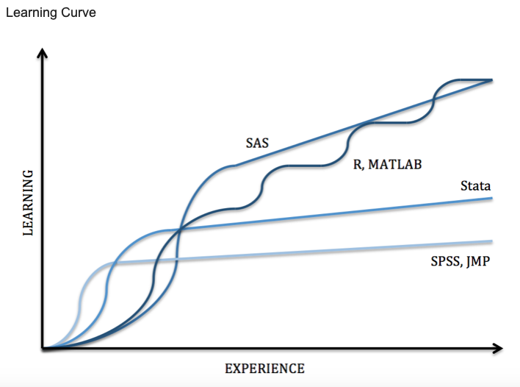
https://guides.nyu.edu/quant/statsoft

Slide 8
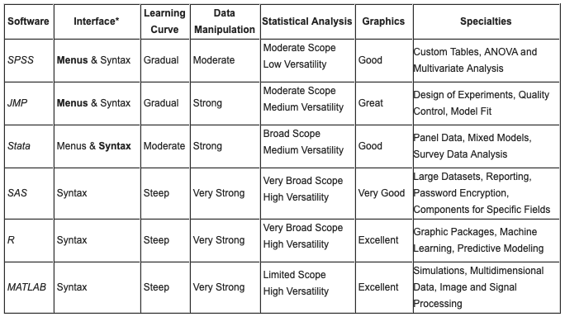
https://guides.nyu.edu/quant/statsoft

Slide 9
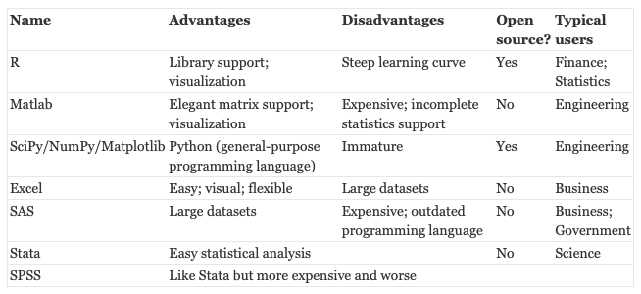
http://brenocon.com/blog/2009/02/comparison-of-data-analysis-packages-r-matlab-scipy-excel-sas-spss-stata/

Slide 10
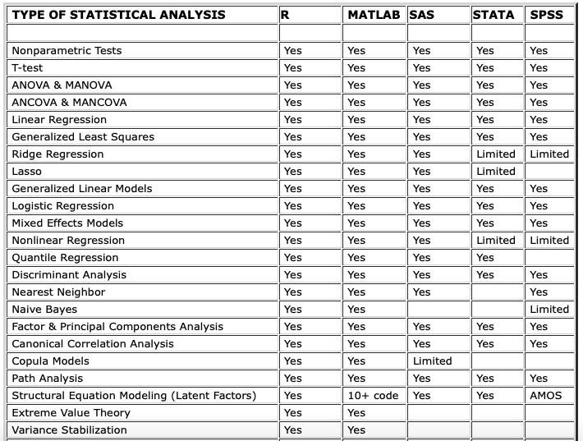
http://stanfordphd.com/Statistical_Software.html

Slide 11
Question ?

